Slide 1
Guest Experience Sentiment Analysis Across Norwegian Cruise Line Ship Classes Using NLP
Applying NLP to evaluate passenger feedback effectively
Notes:
AI-generated content may be incorrect. --- This presentation explores how natural language processing (NLP) techniques are applied to analyze guest experience sentiment across different Norwegian Cruise Line ship classes. We will examine the strategic importance, data overview, methodology, insights, and recommendations for enhancing guest satisfaction.

Slide 2
Agenda Overview
Strategic Importance of Guest Experience Sentiment Analysis
Data Overview: Scope and Composition
Natural Language Processing Methodology
Comparative Sentiment Insights Across Ship Classes
Actionable Recommendations and Future Directions
Notes:
We will discuss the strategic importance of sentiment analysis in guest experience, the data used for this study, the NLP methodology applied, comparative sentiment insights across ship classes, and actionable recommendations and future directions.

Slide 3
Strategic Importance of Guest Experience Sentiment Analysis
Notes:
Understanding guest sentiment is critical for maintaining brand loyalty and improving operational performance. This section discusses how sentiment analysis supports data-driven leadership decisions by identifying experience gaps and linking guest satisfaction to business outcomes.

Slide 4

Link Between Guest Satisfaction and Brand Loyalty
Impact on Brand Loyalty
Guest satisfaction strengthens brand loyalty, leading to repeat bookings and long-term customer relationships.
Role of Sentiment Measurement
Measuring customer sentiment quantifies experiences and informs strategies to improve satisfaction and retention.
Enhancing Brand Reputation
Positive guest experiences boost brand reputation through word-of-mouth and increased customer trust.
Notes:
--- Guest satisfaction directly influences brand loyalty, repeat bookings, and positive word-of-mouth. Measuring sentiment helps quantify these experiences and supports strategies to retain customers and enhance the brand reputation. Image source: Microsoft 365 content library

Slide 5

Operational Impact of Experience Gaps
Impact on Operational Efficiency
Experience gaps reduce operational efficiency, causing delays and lowering service quality in cruise operations.
Effect on Guest Retention
Guest dissatisfaction from experience gaps leads to lower retention and negative reviews for cruise lines.
Sentiment Analysis for Improvement
Identifying experience gaps through sentiment analysis helps prioritize key improvements in service delivery.
Notes:
--- Experience gaps negatively impact operational efficiency and guest retention. By identifying these gaps through sentiment analysis, cruise line operations can prioritize improvements to enhance overall guest satisfaction and streamline service delivery. Image source: Microsoft 365 content library

Slide 6

Role of Sentiment Analysis in Data-Driven Leadership Decisions
Extracting Actionable Insights
Sentiment analysis transforms unstructured guest feedback into meaningful insights that guide leadership decisions.
Aligning Decisions With Customer Needs
Leadership uses sentiment data to make choices that meet customer expectations and enhance satisfaction.
Supporting Continuous Improvement
Ongoing sentiment analysis enables organizations to continuously refine strategies and improve services.
Notes:
--- Sentiment analysis provides actionable insights from unstructured guest feedback, enabling leadership to make informed decisions that align with customer needs and expectations, supporting continuous improvement initiatives. Image source: Microsoft 365 content library

Slide 7
Data Overview: Scope and Composition
Notes:
This section covers the dataset used for analysis, including the source of guest feedback, ship classes included, and the advantages of using unstructured guest comments to gather rich sentiment information.

Slide 8

Description and Source of Guest Feedback Dataset
Dataset Composition
The dataset includes passenger comments from post-cruise surveys and online reviews, capturing diverse guest experiences.
Qualitative Insights
These comments provide qualitative data that reveal detailed insights into guest satisfaction and areas for improvement.
Voyages and Ship Classes
Feedback covers multiple voyages and different ship classes, ensuring a comprehensive overview of cruise experiences.
Notes:
--- The dataset comprises passenger comments collected from post-cruise surveys and online reviews, providing qualitative insights into guest experiences across multiple voyages and ship classes. Image source: Microsoft 365 content library

Slide 9

Ship Classes Included in Analysis
Diverse Ship Classes
The analysis covers multiple ship classes to provide insights across various vessel types in the cruise industry.
Class-Specific Comparison
Comparisons among ship classes help identify unique trends and performance metrics specific to each vessel type.
Sentiment and Performance Trends
Detecting sentiment trends by ship class facilitates targeted improvements and strategic decisions in cruise operations.
Notes:
--- The analysis includes various Norwegian Cruise Line ship classes, enabling comparison across different vessel types to detect class-specific sentiment trends and performance. Image source: Microsoft 365 content library

Slide 10

Advantages of Unstructured Guest Comment Data
Deeper Emotional Insights
Unstructured guest comments reveal detailed emotions and experiences beyond numerical survey data.
Enhanced Sentiment Analysis
Analyzing free-text data enables a more nuanced understanding of guest sentiment and satisfaction.
Notes:
--- Unstructured data such as free-text guest comments offer deeper insights into emotions and experiences that structured surveys may miss, allowing for a more nuanced sentiment analysis. Image source: Microsoft 365 content library

Slide 11
Natural Language Processing Methodology
Notes:
Here we describe the NLP techniques applied, covering data cleaning, sentiment analysis using the VADER model, and aggregation methods to compare sentiment across ship classes.

Slide 12

Data Cleaning and Preprocessing Steps
Noise Removal
Eliminate irrelevant or erroneous data to improve the quality of guest comments for analysis.
Text Normalization
Standardize text by converting to lowercase and correcting inconsistencies for uniform analysis.
Irrelevant Data Filtering
Filter out non-essential information to focus on meaningful content for sentiment analysis.
Notes:
--- Raw guest comments were cleaned by removing noise, normalizing text, and filtering irrelevant data to prepare for accurate sentiment analysis. Image source: Microsoft 365 content library

Slide 13
Application of VADER Sentiment Analysis Model
Optimized for Social Media
VADER is designed specifically for analyzing sentiment in social media and short text messages accurately.
Sentiment Scoring
The model assigns scores that reflect positive, neutral, and negative emotions in guest comments.
Capturing Emotions Effectively
VADER captures subtle emotions in text, providing a comprehensive understanding of guest feedback.
Notes:
--- The VADER model, optimized for social media and short text, was employed to assign sentiment scores to guest comments, capturing positive, neutral, and negative emotions effectively. Image source: Microsoft 365 content library

Slide 14

Aggregation and Comparative Analysis by Ship Class
Sentiment Score Aggregation
Sentiment scores were combined by ship class to summarize guest feedback effectively.
Comparative Evaluation
Comparing sentiment scores across ship classes reveals patterns and differences in guest experiences.
Pattern Identification
This analysis helps identify trends and disparities in guest satisfaction among vessels.
Notes:
--- Sentiment scores were aggregated by ship class to facilitate comparative evaluation, enabling identification of patterns and disparities in guest experiences across vessels. Image source: Microsoft 365 content library

Slide 15
Comparative Sentiment Insights Across Ship Classes
Notes:
This section presents findings on sentiment performance by ship class, highlighting best and underperforming classes as well as areas needing further attention.

Slide 16
Best-Performing Ship Classes According to Sentiment
High Positive Guest Sentiment
Certain ship classes consistently receive high positive feedback from guests, highlighting excellent experiences onboard.
Successful Operational Practices
Operational practices on these ships contribute to smooth sailing and guest satisfaction, setting standards to emulate.
Replicable Success Models
The successful strategies from these ship classes provide models that can be adopted by others in the industry.
Notes:
--- Some ship classes exhibited consistently high positive sentiment, reflecting strong guest satisfaction and successful operational practices worth replicating. Image source: Microsoft 365 content library

Slide 17

Identification of Underperforming Ship Classes
Lower Sentiment Scores
Some ship classes received lower guest sentiment scores, signaling potential dissatisfaction among passengers.
Guest Experience Issues
The lower scores highlight areas in guest experience requiring targeted improvements for better satisfaction.
Notes:
--- Certain ship classes showed lower sentiment scores, indicating potential issues in guest experience that warrant targeted improvement efforts. Image source: Microsoft 365 content library

Slide 18
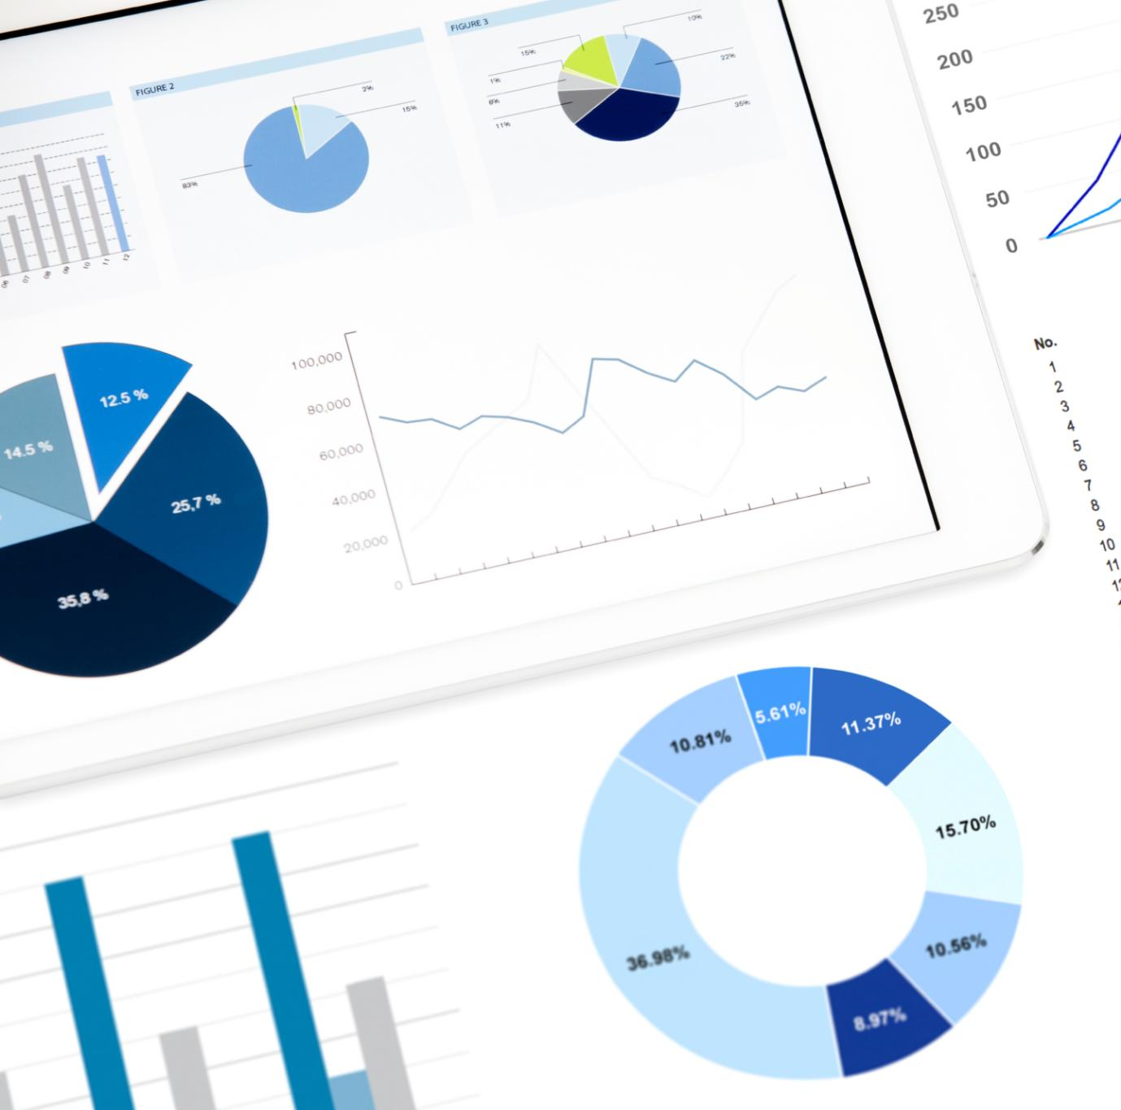
Areas Requiring Further Investigation and Improvement
Identified Experience Weaknesses
Certain experience areas like dining and onboard activities showed comparatively weaker customer sentiment in analysis.
Focus for Enhancements
These identified areas guide targeted improvements to elevate overall customer satisfaction and experience quality.
Role of Sentiment Analysis
Sentiment analysis plays a crucial role in pinpointing specific areas requiring further investigation and enhancement.
Notes:
--- Analysis uncovered specific experience dimensions, such as dining or onboard activities, where sentiment was comparatively weaker, guiding areas for focused enhancements. Image source: Microsoft 365 content library

Slide 19
Actionable Recommendations and Future Directions
Notes:
Based on sentiment findings, this section outlines operational changes, continuous monitoring strategies, and opportunities to enhance sentiment analysis capabilities.

Slide 20
Operational Changes Based on Sentiment Findings
Sentiment Analysis Insights
Sentiment analysis identifies key areas where customer feedback indicates need for service improvement.
Targeted Service Improvements
Focused enhancements based on sentiment data help improve guest experiences effectively.
Enhanced Guest Satisfaction
Implementing changes leads to higher guest satisfaction and better operational outcomes.
Notes:
--- Implementing targeted service improvements in areas highlighted by sentiment analysis can elevate guest satisfaction and operational effectiveness. Image source: Microsoft 365 content library

Slide 21

Strategies for Continuous Feedback Monitoring
Ongoing Sentiment Monitoring
Continuous sentiment tracking helps identify customer experience issues as they arise for timely resolution.
Proactive Issue Management
Early detection of feedback enables proactive responses that enhance guest satisfaction and loyalty.
Sustaining Guest Delight
Consistent monitoring and quick actions help maintain high levels of guest delight and positive experiences.
Notes:
--- Establishing ongoing sentiment monitoring systems ensures timely detection of experience issues, allowing proactive management and sustained guest delight. Image source: Microsoft 365 content library

Slide 22

Potential Enhancements to Sentiment Analysis
Advanced NLP Models
Integrating advanced natural language processing models improves sentiment analysis accuracy and contextual understanding.
Multilingual Feedback
Incorporating multilingual feedback expands sentiment analysis capabilities across different languages and cultures.
Refined Sentiment Granularity
Refining sentiment granularity helps capture subtle emotional nuances for deeper insights.
Notes:
--- Future work may include integrating advanced NLP models, incorporating multilingual feedback, and refining sentiment granularity to capture deeper insights. Image source: Microsoft 365 content library

Slide 23
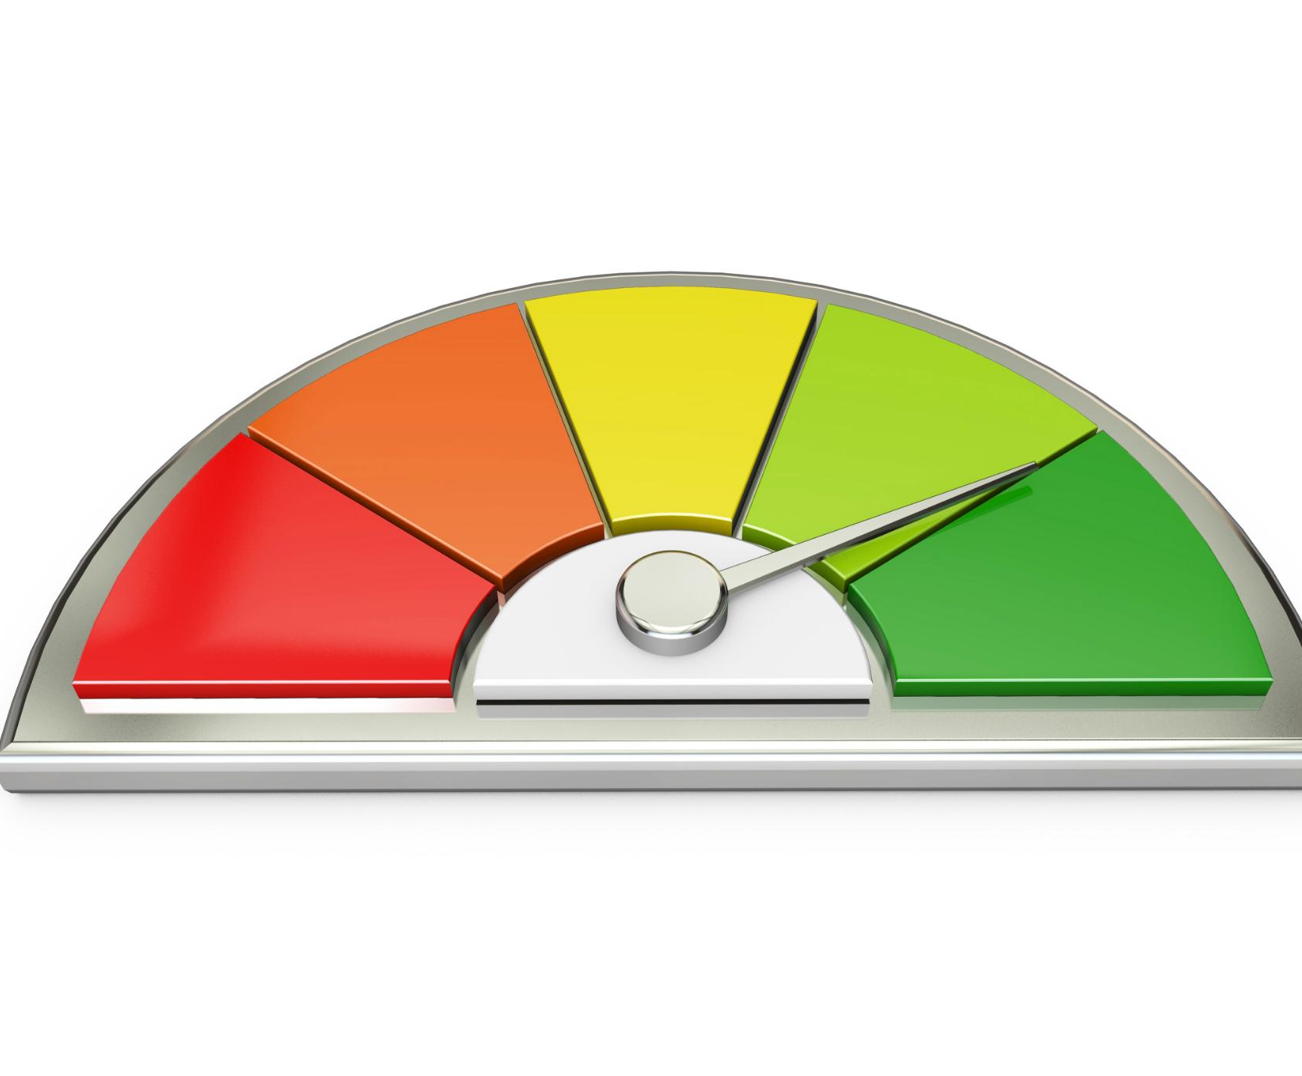
Understanding Sentiment Scores
Sentiment Score Scale
Sentiment scores range from –1.0 for very negative to +1.0 for very positive, with 0.0 as neutral.
Interpreting Guest Feedback
Positive comments like 'Amazing service' yield high scores, while negative feedback such as 'disappointing experience' scores low.
Measurable Insights for Comparison
Sentiment scoring transforms qualitative comments into measurable data, allowing for objective, large-scale comparison.
Notes:
Image source: Microsoft 365 content library A sentiment score reflects the emotional tone of guest comments, ranging from –1.0 (very negative) to +1.0 (very positive), with 0.0 as neutral. For example, 'Amazing service and friendly staff' receives a positive score, while 'Very disappointing experience' is negative. This score converts qualitative feedback into measurable insights, enabling objective comparison at scale.

Slide 24
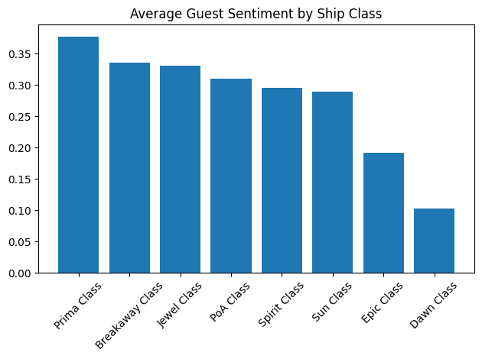
Guest Sentiment by Ship Class
Prima Class Excellence
Prima Class ships receive the highest average guest sentiment, showing outstanding guest experiences and high satisfaction levels.
Breakaway and Jewel Consistency
Breakaway and Jewel Classes consistently deliver strong performance, providing reliable guest satisfaction across multiple voyages.
Epic and Dawn Improvement Areas
Epic and Dawn Classes have lower sentiment scores, indicating opportunities to improve services and amenities for guests.
Notes:
Image source: Microsoft 365 content library Prima Class leads with the highest average guest sentiment, reflecting exceptional guest experiences. Breakaway and Jewel Classes maintain consistently strong performance, indicating reliable satisfaction across voyages. In contrast, Epic and Dawn Classes report notably lower sentiment scores, highlighting areas for potential improvement in services and amenities.

Slide 25
Key Insights Overview
Prima Class Excellence
Prima Class leads in guest experience, setting the benchmark for premium hospitality and exceeding expectations.
Strong Mid-Tier Performance
Breakaway and Jewel Classes deliver stable, positive sentiment and value-for-money appeal for mid-tier travelers.
Risks from Underperformance
Epic and Dawn Classes show dissatisfaction, posing risks to brand reputation and financial performance.
Notes:
Image source: Microsoft 365 content library Prima Class excels in guest experience, setting the standard for premium expectations. Breakaway and Jewel Classes demonstrate strong mid-tier performance with stable, positive sentiment, highlighting their value-for-money appeal. Epic and Dawn Classes, however, are underperforming and generating dissatisfaction, presenting potential risks to both brand reputation and revenue.

Slide 26

Business Actions & Insights
Root-Cause Analysis
Identify key dissatisfaction factors in Epic and Dawn Classes by analyzing service, food, and amenities.
Aligning Expectations
Ensure premium class expectations match real experiences by improving consistency in marketing and delivery.
Benchmarking Best Practices
Use Prima Class as a benchmark to adopt best practices for service and experience improvements.
Notes:
Image source: Microsoft 365 content library Conduct a detailed root-cause analysis for Epic and Dawn Classes to identify dissatisfaction drivers like service, food, and amenities. Align premium class expectations with the actual experience, ensuring marketing and delivery are consistent. Leverage best practices from top-performing classes, using Prima Class as a benchmark for service and experience improvements.

Slide 27
Limitations & Next Steps
Sentiment Analysis Limitations
Sentiment analysis detects emotional tone but cannot measure operational metrics directly. It should complement structured surveys, not replace them.
Theme and Complaint Analysis
Theme analysis will identify main complaint drivers, providing deeper context beyond emotional tone alone.
Future Integration Steps
Sentiment data will be segmented by experience area and linked to operational KPIs for targeted improvements.
Notes:
Image source: Microsoft 365 content library Sentiment analysis detects emotional tone but does not measure operational metrics. It should complement, not replace, structured surveys or NPS analysis. Next, theme analysis will uncover key complaint drivers, sentiment will be segmented by experience area, and insights will be linked to operational KPIs for targeted improvements.

Slide 28

Guest Sentiment Distribution
Majority Positive Response
Sixty-five percent of guests expressed positive sentiment, showcasing overall satisfaction and success in service delivery.
Noticeable Negative Experiences
Twenty-eight point six percent of guests reported negative experiences, revealing areas where improvements are needed.
Opportunity for Improvement
With nearly one in three guests dissatisfied, there is significant opportunity to enhance service and overall experience.
Notes:
Image source: Microsoft 365 content library Guest feedback shows 65% positive sentiment, with 28.6% expressing negative experiences and 6.4% remaining neutral. The majority feel satisfied, highlighting overall success. However, almost one in three comments reveal dissatisfaction, indicating a significant opportunity for service and experience improvement going forward.

Slide 29
Conclusion
Sentiment Analysis Benefits
Analyzing guest feedback reveals valuable insights to enhance guest experiences and service quality.
Leadership Decision Support
Data-driven insights empower leaders to make informed decisions for cruise operations and guest satisfaction.
Operational Excellence
Ongoing use of sentiment analysis ensures continuous improvement and strengthens customer loyalty.
Notes:
Sentiment analysis of guest feedback across Norwegian Cruise Line ship classes provides actionable insights that drive improved guest experiences and informed leadership decisions. Continuous application of these methods supports sustained operational excellence and customer loyalty.

